Slide 1
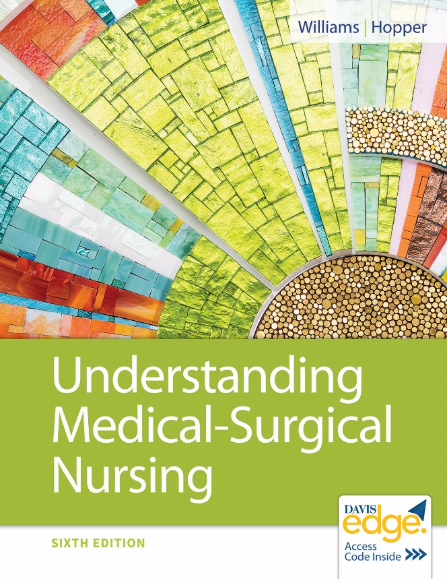
Chapter 45
Musculoskeletal Function and Assessment

Slide 2
Learning Outcomes
Explain the anatomy and function of the musculoskeletal system.
Describe the effects of aging on the musculoskeletal system.
List subjective data that are collected when caring for a patient with a disorder of the musculoskeletal system.
List objective data that are collected when caring for a patient with a disorder of the musculoskeletal system.

Slide 3
Learning Outcomes (continued)
List areas included in a neurovascular assessment for the musculoskeletal system.
Identify diagnostic tests for musculoskeletal problems.
Describe the nursing care provided for patients undergoing diagnostic tests of the musculoskeletal system.

Slide 4
Skeletal System Tissues
Bone
Cartilage
Fibrous connective tissue (ligaments)

Slide 5
Skeletal System Functions
Movement
Protection
Stores calcium

Slide 6
Muscular System Tissues
Skeletal muscle
Fibrous connective tissue (tendons)
Fasciae

Slide 7
Muscular System Functions
Movement
Heat production
Blood return from legs

Slide 8
Bone Tissue
Osteocytes
Calcium salts
Collagen
Periosteum

Slide 9
Growth of Bone
Osteoblasts produce bone growth and repair bone.

Slide 10
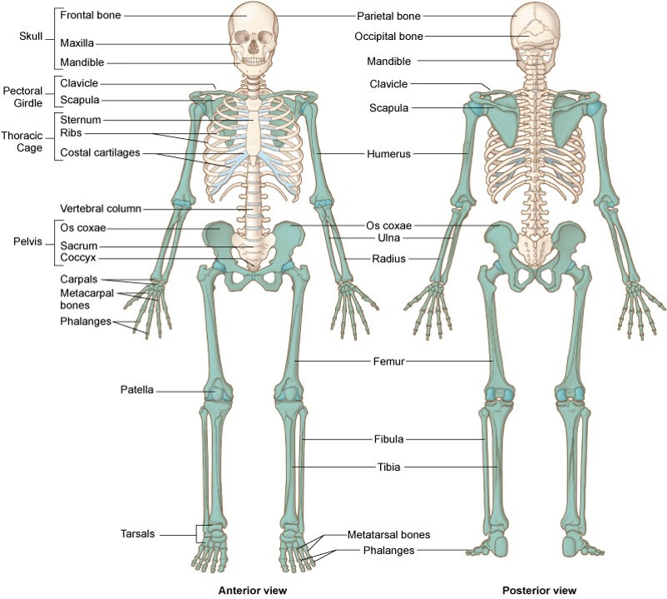
Skeleton

Slide 11
Structure of Skeleton
206 bones
Axial skeleton
Skull, hyoid, vertebral column, rib cage
Appendicular skeleton
Arms/legs, shoulder, pelvic girdles
Synovial joints

Slide 12
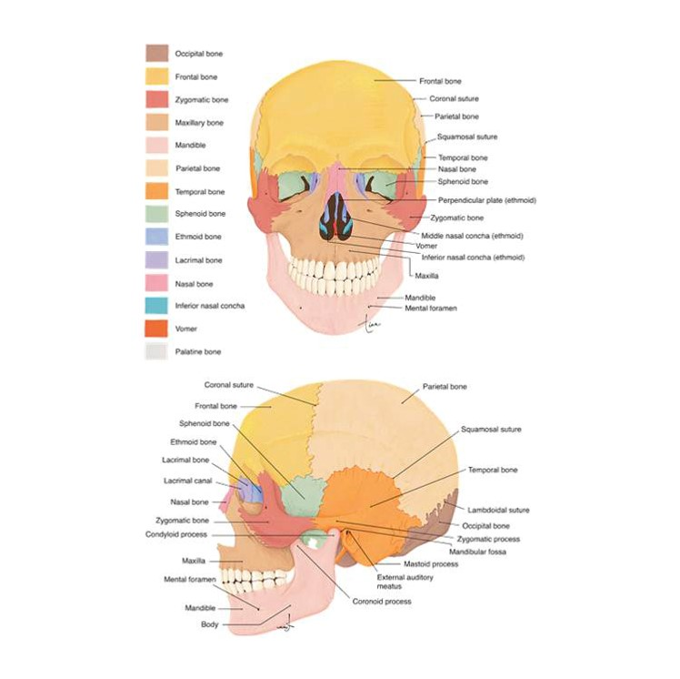
Anterior and Lateral Skull

Slide 13
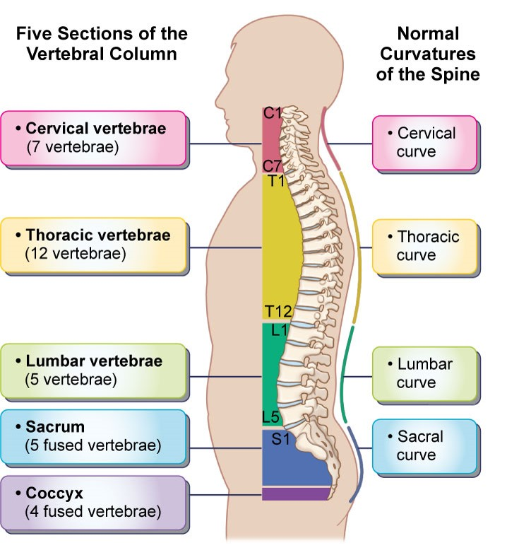
Vertebral Column

Slide 14
Thoracic Cage
12 pairs of ribs
Sternum
Protects heart, lungs, liver, spleen
Expands chest cavity for inhalation

Slide 15
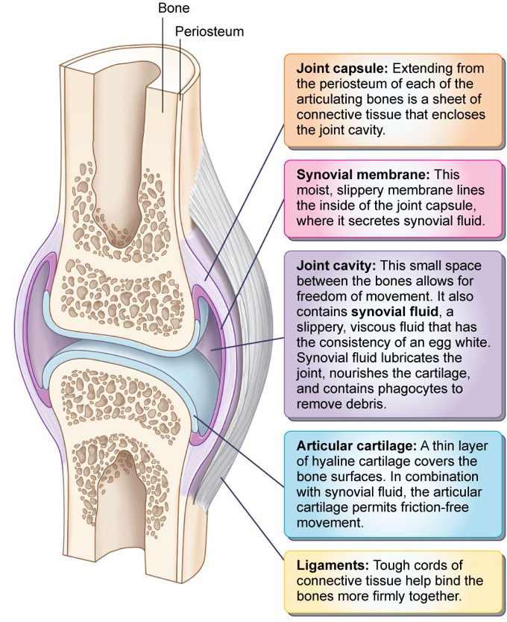
Synovial Joint

Slide 16
Synovial Joint (continued)
Contains synovial fluid
Many contain bursae
Small sacs of synovial fluid between joint and other structures
Lessen wear in areas of friction
Can become inflamed

Slide 17
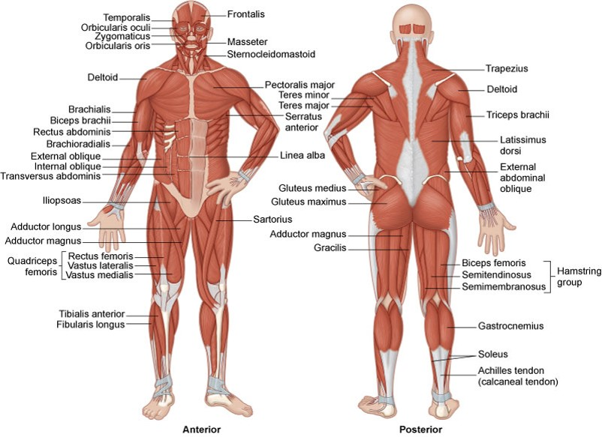
Skeletal Muscles

Slide 18
Muscle Structure and Arrangements
About 700 muscles
Anchored to bones by tendons
Antagonistic muscles
Synergistic muscles
Maintains balance
Fine motor control

Slide 19
Role of Nervous System
Skeletal muscles are voluntary muscles.
Muscles require nerve impulses for contraction.

Slide 20
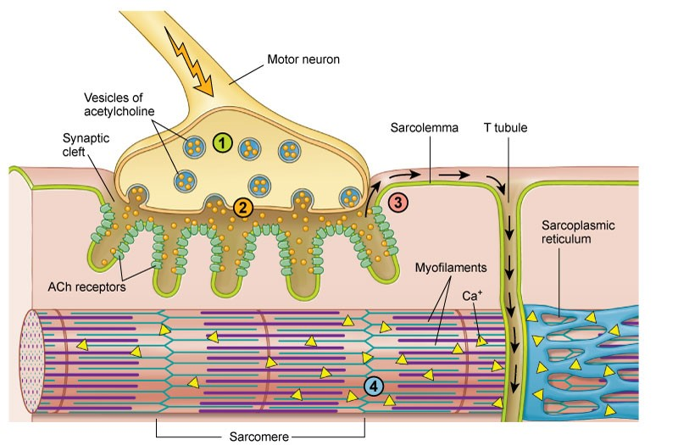
Neuromuscular Junction

Slide 21
Neuromuscular Junction
Termination of motor neuron on muscle fiber
Contains neurotransmitter acetylcholine
Nerve impulse arrives at terminal
Release of acetylcholine (A C h) across synaptic cleft
A C h bonds to A C h receptors
Sarcomere shortens

Slide 22
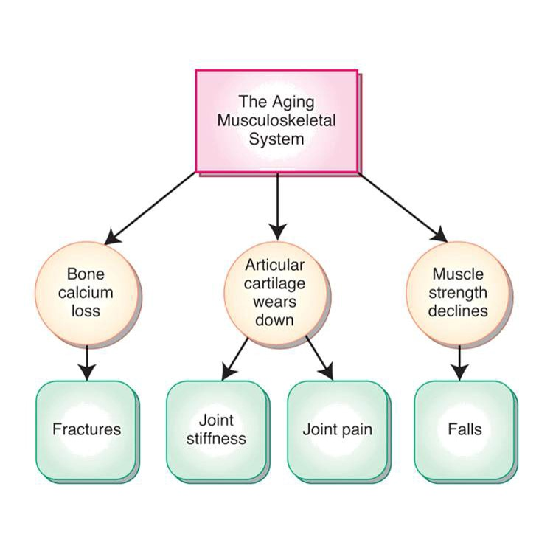
Aging and the Musculoskeletal System

Slide 23
Aging and the Musculoskeletal System
Decreased muscle mass/strength
Decreased elasticity of ligaments, tendons, cartilage
Decrease in intervertebral space
Changes in posture and gait changes

Slide 24
Effects of Age-Related Changes to the Musculoskeletal System
Impaired mobility
Increased risk for falls
Pain

Slide 25
Musculoskeletal System Data Collection
Subjective data
History
Injury
Occupation
Family history
Nutritional history
Psychosocial
Deformities affect body image

Slide 26
Musculoskeletal System Data Collection (continued)
Physical examination
Inspection
Palpation
Range of motion
Muscle tone

Slide 27
Physical Examination
Inspection
Posture
Gait
Mobility aids
Deformities
Crepitation
Palpation
Warmth
Tenderness
Neurovascular checks
Range of motion
Activities of daily living
Hands: Opposition, fist
Muscle tone

Slide 28
Diagnostic Tests
Serum laboratory tests
Alkaline phosphatase
Calcium
Phosphorus
Myoglobin
Muscle enzymes
Uric acid

Slide 29
Diagnostic Tests (continued_1)
Arthrocentesis
Arthroscopy
Bone or muscle biopsy
Bone density scan
Computed tomography (C T) scan
Magnetic resonance imaging (M R I)

Slide 30
Diagnostic Tests (continued_2)
Myelography
Nerve conduction studies
Electromyography
Nuclear medicine scans
Radiographs (x-rays)
Ultrasonography

Slide 31
Review Question
Which of these are age-related changes to the musculoskeletal system? Select all that apply.
Increased muscle strength
Increased elasticity of ligaments, tendons, cartilage
Decrease in intervertebral space
Changes in posture and gait changes
Decreased muscle mass

Slide 32
Review Question Answer
Correct Answer: 3, 4, 5

Slide 33
Review Question (continued_1)
What subjective data should the nurse collect for a patient with a fractured arm? Select all that apply.
Inspection of skin color at injury site
Palpation of skin temperature
Occupation
Family history
Nutritional history
Range of motion

Slide 34
Review Question Answer (continued_1)
Correct Answer: 3, 4, 5

Slide 35
Review Question (continued_2)
The nurse asks the patient to perform which of these to check muscle strength? Select all that apply.
Blink.
Cough.
Push feet against nurse’s hands.
Squeeze nurse’s hands.
Swallow.
Wiggle toes.

Slide 36
Review Question Answer (continued_2)
Correct Answer: 3, 4

Slide 37
Review Question (continued_3)
Which of these serum blood tests would the nurse review as an indicator of bone health?
Calcium
Muscle enzymes
Myoglobin
Uric acid

Slide 38
Review Question Answer (continued_3)
Correct Answer: 1

Slide 39
Review Question (continued_4)
What actions should the nurse take for a patient’s increased pain unresponsive to analgesics after a bone biopsy? Select all that apply.
Administer higher analgesic dose.
Observe site for hematoma.
Perform neurovascular checks.
Notify the health care provider.
Administer aspirin.

Slide 40
Review Question Answer (continued_4)
Correct Answer: 2, 3, 4

